Slide 1

Personalized Screen Reader Speed Adjustment & Insights
Team Members:
Bhuvanesh Marineni
Durga Janakala
Harshit Koncharla
Deevan Kumar Menda

Slide 2
Contents
Introduction
Overview Of NVDA Startup and Features
Implementation
Logger Setup
Dataset Overview for Model Training
Model Training for Speed Adjustment
Content Categorization
Implementing Automatic Speed Adjustment in NVDA
Results
Conclusion
Future Work

Slide 3
Introduction:
Screen readers are essential assistive technologies that allow visually impaired individuals to access digital content via spoken or Braille output. Traditionally set at a fixed speed, these tools often struggle with varying content complexities. This project aims to develop an adaptive system that dynamically adjusts narration speeds based on user interactions and preferences. This approach will enhance usability and accessibility, ensuring that the reading speed matches the content complexity and the user’s familiarity, thereby setting a new standard in digital accessibility for visually impaired users.

Slide 4
Problem Statement:
The primary objective of this project is to develop a personalized screen reader speed adjustment system that can adapt to individual user preferences and provide insights into their reading behaviour and log this data for continuous improvement. The primary objective of this project is to develop a personalized screen reader speed adjustment system tailored to individual user preferences.

Slide 5
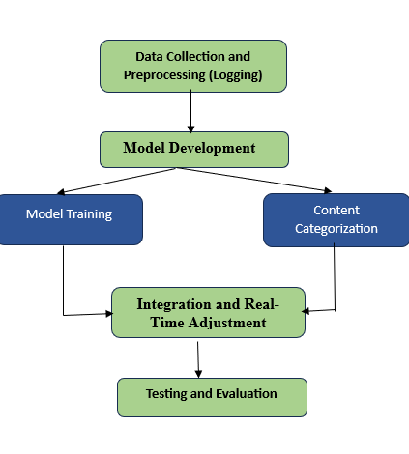
Proposed Architecture
Notes:
Data Collection and Preprocessing (Logging): Gather information on how users change the speed of their screen readers while reading different types of content.
Model Development: Use the collected data to build a model. This involves two main tasks:
Model Training: Teach the model to understand user preferences and predict the best reading speeds.
Content Categorization: Organize content into categories like news or technical material to help the model make better speed adjustments.
Integration and Real-Time Adjustment: Incorporate the trained model into the screen reader software so it can automatically adjust the reading speed based on the content and preferences in real-time.
Testing and Evaluation: Check how well the system works by testing it with users and evaluating their satisfaction and the accuracy of the speed adjustments.

Slide 6
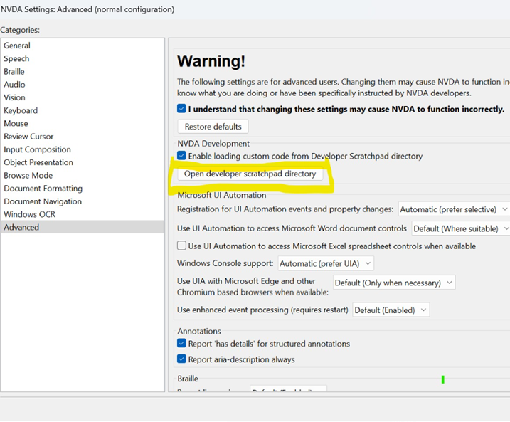
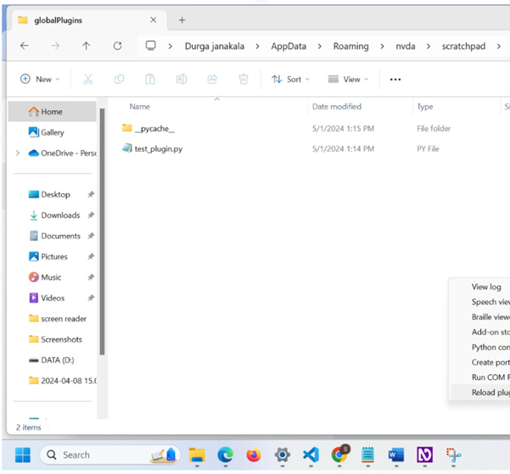
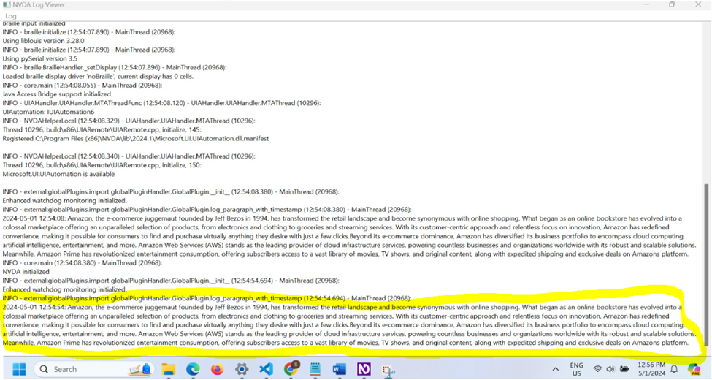
Logger Setup
Notes:
Step 1: Download Logger.py from GitHub.
Step 2: In NVDA, go to preferences → settings → advanced, enable custom code loading, and open developer scratchpad directory.
Step 3: Upload the logger file in global plugins.
Step 4: Select tools → Reload plugins.
Step 5: To view logs, select tools → view log.

Slide 7
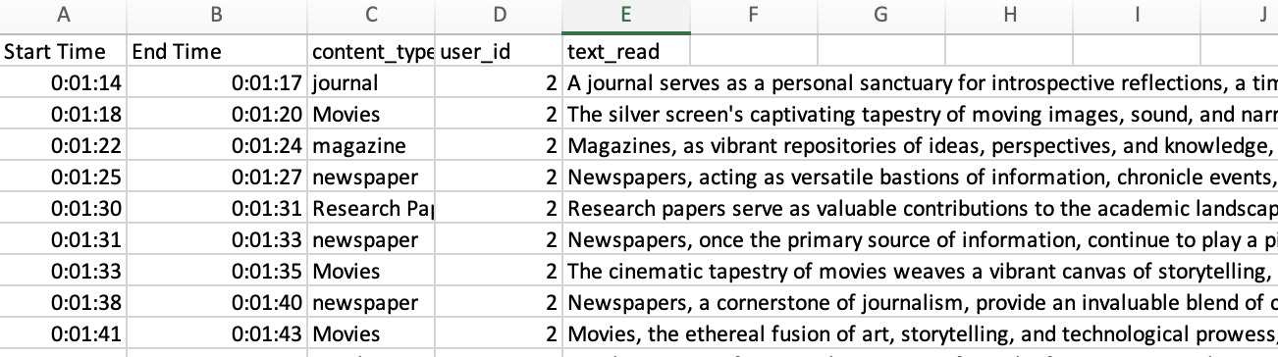
Dataset Overview for Model Training
Time Tracking: Logs 'Start Time' and 'End Time' for user interactions, formatted as hh:mm:ss:ff.
Content Categorization: Classifies content into categories like journals, movies, and research papers for tailored speed adjustments.
User Identification: Tracks interactions using 'User ID' to analyze preferences and behavior patterns.
Content Insights: 'Text Read' provides content snippets, aiding in speed customization based on complexity.

Slide 8
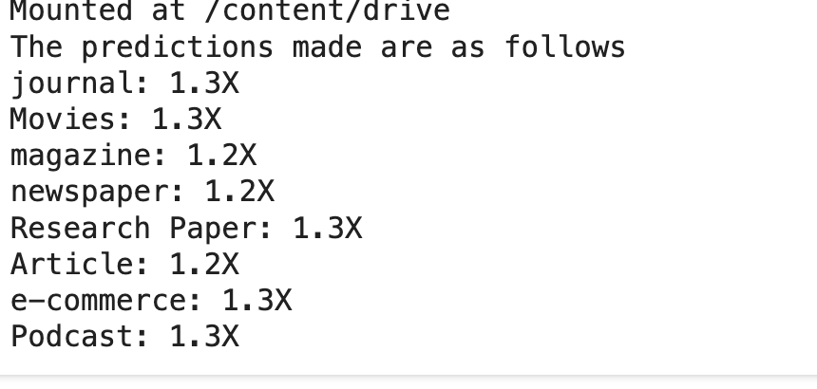
Model Training for Speed Adjustment
The RandomForestRegression model is a robust ensemble learning technique that uses multiple decision trees to predict outcomes and improve accuracy.
In this project, it processes data by first normalizing reading times and applying OneHot encoding to categorical variables such as content type.
This setup allows the model to handle various content types effectively, adjusting reading speeds dynamically.
By splitting the data into training and testing sets, the model optimizes its predictions for speed multipliers, significantly enhancing text-to-speech systems.
These adjustments ensure that reading speeds are aptly matched to the complexity and familiarity of different types of content, improving accessibility and engagement for users with visual impairments.
Notes:
Significance of the RandomForestRegression Model:
The RandomForestRegression model plays a crucial role in this project by leveraging the power of ensemble learning to increase the accuracy and reliability of predictions regarding optimal reading speeds. Its use of multiple decision trees helps mitigate overfitting, a common problem in predictive modeling, ensuring that the predictions are not only precise but also generalizable across different types of unseen data. By accurately predicting speed multipliers for various content types, the model allows for dynamic adjustment of reading speeds in screen readers, significantly enhancing the reading experience for individuals with visual impairments. This adaptive capability makes digital content more accessible and navigable, promoting greater independence and user satisfaction.
Significance of OneHot Encoding:
OneHot Encoding is essential for converting categorical data into a numerical format that can be effectively used by the RandomForestRegressor model. This transformation is crucial because machine learning algorithms process numerical input better and cannot directly handle categorical data. By using OneHot Encoding on the 'content_type' variable, each category (such as journals, movies, etc.) is represented as a unique vector within a larger matrix, which distinctly identifies the presence or absence of each category with binary data. This encoding not only simplifies the processing of categorical data but also enhances the model’s ability to discern and learn the different impacts of various content types on reading speed preferences. This, in turn, enables the tailored adjustment of reading speeds, directly contributing to the system’s adaptability and accuracy.

Slide 9
Content Categorization
API Configuration & Model Selection
Model Used: gemini-pro from Google's generative AI suite, known for its robust content analysis capabilities.
API Security: Configuration includes secure API key management to ensure safe and reliable access.
Prompt Construction for Content Identification
Prompt Details: The prompt instructs the AI model to classify the text into categories such as Article, Movies, Podcast, and more, enhancing the specificity of content analysis.
Model Interaction and Predictive Analysis
Execution: Sends a detailed prompt to the model, which analyzes the text and predicts the content type from the given input

Slide 10

Implementing Automatic Speed Adjustment in NVDA
Objective:
Integrate content categorization within NVDA for automatic speed adjustments. Currently using manual selection due to hosting constraints.
Implementation Steps:
Step 1: Download Adjustment.py from GitHub.
Step 2: Access NVDA settings:
Right-click NVDA icon → Preferences → Settings.
Advanced settings: Enable loading custom code.
Step 3: Upload Adjustment.py to global plugins.
Step 4: Reload plugins via Tools menu.
Outcome:
Enables manual speed adjustments as a temporary solution, setting the stage for future automation.

Slide 11
Challenges Encountered
Initial NVDA Integration Issues:
We encountered initial difficulties with integrating our plugins into the NVDA environment. This required us to obtain specific access permissions to interact with the NVDA server, ensuring our plugins could operate seamlessly within the existing framework.
Watchdog Time Freeze Error:
During development, we faced issues with the NVDA watchdog timer freezing, which disrupted the plugin's functionality. This problem was resolved by modifying our debugging approach, specifically by removing the frequent printing of timestamps which alleviated the system's load and parevented the freeze.
Implementation of Automatic Speed Adjustment:
To enable the Automatic Speed Adjustment feature, it is essential to integrate content categorization directly within the NVDA plugin on local machines. This process involves hosting our machine learning model on a cloud platform and accessing it through an API endpoint. Due to current hosting limitations, we have provisionally adopted a manual method for selecting the content type within the plugin, planning to shift to fully automated categorization once the hosting constraints are addressed.

Slide 12

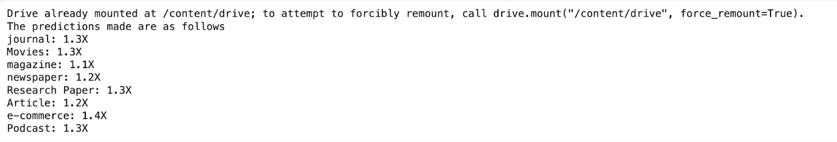
Results
Effective Data Logging: Captured essential user interaction details, enabling insights into preferences and behaviors.
Accurate Model Predictions: RandomForestRegressor accurately predicted speed adjustments based on content types, validated by user feedback.
User Experience Enhancements:
Increased Accessibility: Tailored digital content accessibility for users with visual impairments.
Enhanced Reading Comfort: Adjusted reading speeds improved engagement with varied content.

Slide 13
Conclusion & Future Work
Achievements:
Developed a machine-learning system to dynamically adjust reading speeds of screen readers.
Enhanced adaptability and personalization for visually impaired users, aligning with individual preferences.
Future Directions:
Expanding Data Collection: Increase user data volume and diversity for refined model accuracy.
Enhanced Content Analysis: Broaden categorization capabilities to cover more content types and complexities.
Integration with Other Technologies: Explore synergies with other assistive technologies for comprehensive user support.
Hosting on Cloud Platform: Transition content categorization model to cloud for real-time API access, automating speed adjustments for a seamless experience.

Slide 14
References:
1.Design of An Electronic Narrator on Assistant Robot for Blind People
https://www.matec-conferences.org/articles/matecconf/pdf/2016/05/matecconf_iccma2016_03013.pdf
2.Understanding the Usages, Lifecycle, and Opportunities of Screen Readers’ Plugins
https://dl.acm.org/doi/full/10.1145/3582697
3.Screen Reader Voices: Effects of Pauses and Voice Changes on Comprehension
https://journals.sagepu.com/doi/epdf/10.1177/1071181322661291

